Slide 1
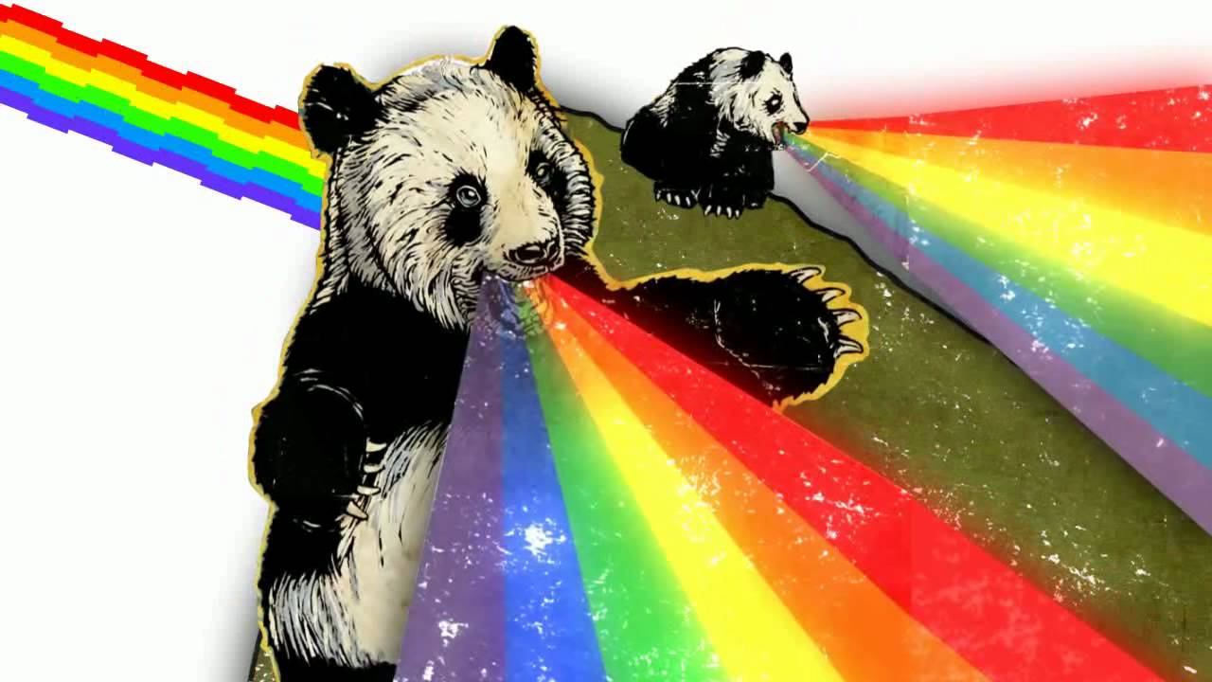
What is github?
Wifi SSID: “We Work” pass: P@ssw0rd

Slide 2
Git vs Github?
Git is essentially “Track changing” in Word (Thanks Kodjo!)
Github/BitBucket/Gitlabs are collaboration services that puts “Git” in the cloud.

Slide 3
Why do I want to use it?
Writing code = team based activity. Github.com allows for easy collaboration with the team.
Great way to go back and fix stuff
Great way to see productivity
Lots of other features we won’t talk about today

Slide 4
Seems scary
It’s not, because this slide says so☺
Built into OSX (mac) and linux by default
All servers have it built in
All developers should already use it***
Fantastic support/community!

Slide 5
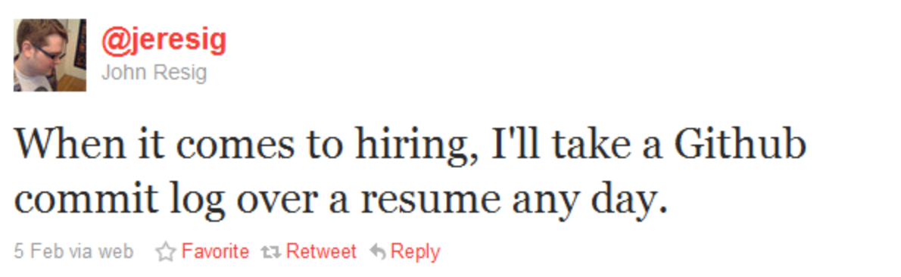
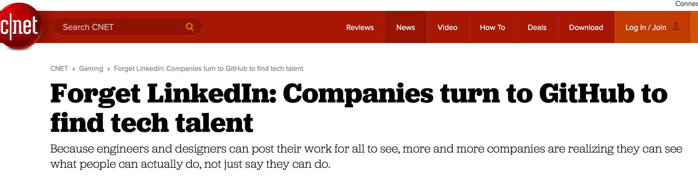

Slide 6
Github.com, vs gitlabs.com, vs bit bucket.com
All the same thing, just different services.
Similar to “starbucks vs pete’s vs dunken donuts” They all sell coffee.
All work pretty much the same
Bitbucket is free
Github has a GUI

Slide 7
What’s a repository (aka. Repo)?
A repository is a group of files that make up a code base.
Think of it as a folder on a computer
Private vs Public.
One is private to you and your team only. The other one….

Slide 8
Basic features/commands
Git init (get started)
Git add . (add my changes)
Git commit –am “comment goes here” (add a note to my push)
Git push (move from my computer to github)
Git branch (OMG! What’s a bRANcH!)
Git checkout (switch to an old commit or branch).

Slide 9


Slide 10
Git init
This one is pretty straight forward, Git init = git initialize.
This tells git “hey, pay attention to what I’m doing in this folder”.

Slide 11
Git add
This tells git to add all the changes you just made
Command line:
Git add [file name I changed]
Other options:
Git add .
(notice the dot). This tells git “Yo, I changed a lot of files, add them all”

Slide 12
Git commit
A commit is like a “save” point. It’s a point in time that git knows stuff changed.
Good metric of productivity, lots of commits means lots of code that was added (or subtracted)

Slide 13
Commit continued
Example on live repo
Productivity
Watching devs
Blame

Slide 14
Git push
A “push” is when you take a copy of what’s on your computer, and “push” it to github.com.
Why? So everyone else on your team can see what you did. Example:
Keith makes edits to hello.txt
Claire also makes her own edits to hello.txt
Ryan comes in, and adds his own stuff to hello.txt
Now what? Github knows when/where each person made changes and manages them so they work well**

Slide 15
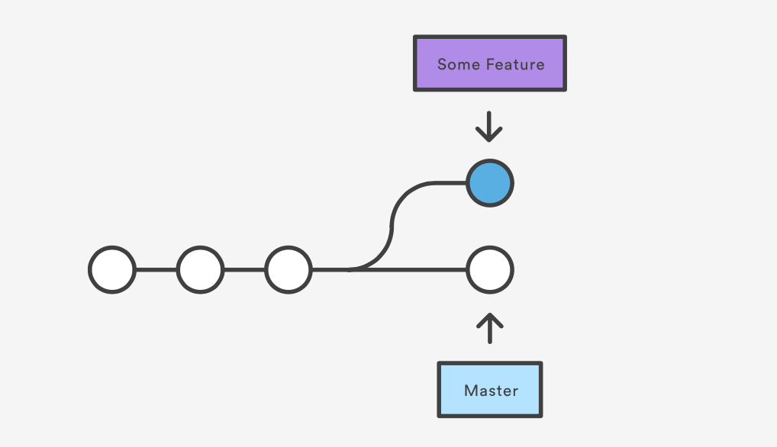
Git branch
Branches are similar to the previous concepts.
Why you branch?

Slide 16
Git merge
Merges changes between branches.
master Branch: Some Feature Branch:
File1.txt
Created by Keith
File1.txt
Edited by Ryan Claire Kodjo
Git merge takes all of Ryan, Claire and Kodjo’s changes into the master branch. Now
File1.txt has everyone’s edits and everyone who is working on this project has the
Exact same version of file1.txt
Imagine this over a few hundred files and a team of 10 people

Slide 17
So much m0ar!
This is 1% of what git (and github) is capable of.
Other uses? Take someone else’s code!
https://github.com/Netflix
https://github.com/twitter
Make webpages directly from github (Charlie wrote up a blog about it CharlesDouglasOsborn.com)

Slide 18
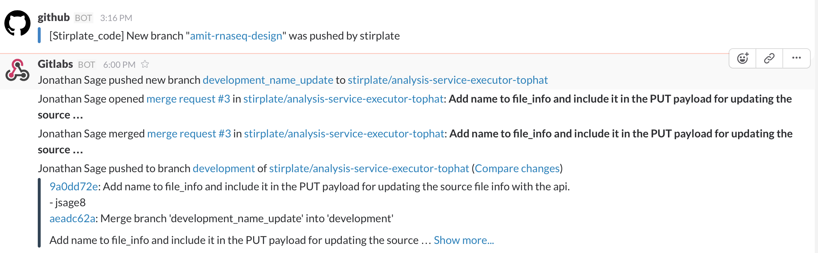

Slide 19
Hands on, lets jump in
Go to www.github.com
Not using the command line?
Google “Github for desktop” and download it
2 ways to interact w/ git.
- command line ☺
- GUI ☹

